Slide 1
Remote Peering
Zaid Ali
LinkedIn Corporation

Slide 2
Observations
Number of IXP’s are increasing
Peering density at IXP’s are growing
Transit prices are dropping
Sound business cases for peering
More love between content & eyeballs
Higher adoption of remote peering

Slide 3
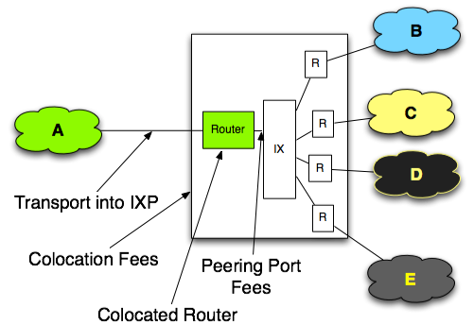
Traditional peering model

Slide 4
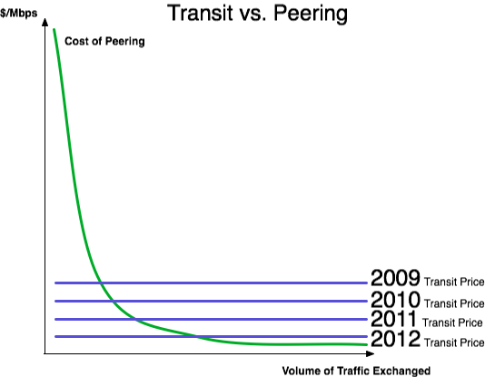
Challenges with traditional model
Cost is fixed
Transit drops faster than IXP port/co-location costs & routers
For large traffic volume
peering makes $$ sense.
What about for the rest
& performance argument?

Slide 5
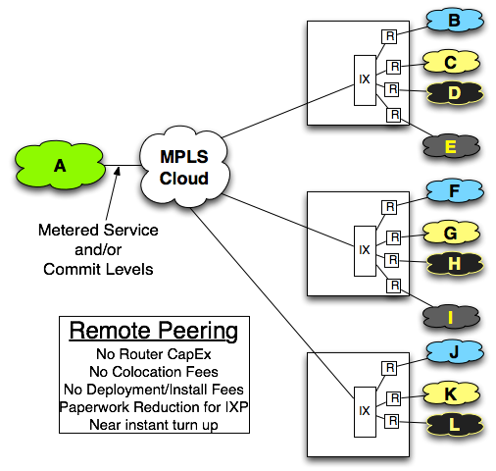
Remote Peering model

Slide 6
Router configs
interface GigabitEthernet0/1/2
description Your_Favourite L2 Transport_Provider
no ip address
no ip proxy-arp
load-interval 30
negotiation auto
!
interface GigabitEthernet0/1/2.861
description IXP1
encapsulation dot1Q 861
ip address 1.1.1.2 255.255.252.0
ip access-group ACL in
ip access-group ACL out
no ip proxy-arp
!
interface GigabitEthernet0/1/2.1835
description IXP2
encapsulation dot1Q 1835
ip address 2.2.2.10 255.255.252.0
ip access-group ACL in
ip access-group ACL out
no ip proxy-arp
!

Slide 7
Business case: Closer to eyeballs at lower cost
 | Traditional Peering | Remote Peering
CapEx for 4 POP's | $1.1M (275K/POP) | $0
OpEx for 4 POP's | $15K/month | $0
Circuit costs to connect POP's | $6K/month | $1200/month (1G)
* Data courtesy of Drpeering.net

Slide 8
Our experience/advise
You probably don’t want to do remote peering across continents or where latency doesn’t work in your favor.
Try to take the hybrid approach where you blend traditional IXP setup with remote peering
Remote peering is a great way to get closer to eyeballs and grow your peering while you are building out your global backbone
IXP’s treat you the same even if you come through a partner. Keep doing this!

Slide 9
The debate
L2 service adding more complexity
Harder to monitor
Complex to debug issues compared to L1
Added latency
Remote peering can lead to routing inefficiency
Breaks the model of “Peering keeps local traffic local”
Latency benefits could disappear?
Higher adoption of remote peering could lead to routing problems or anomalies
Dropping bits on the floor waiting on BGP timers
L2 service drops but you have to wait on timers
Argue: How is this different from peering across multiple switches?
Commitment issues
Not physically present may mean you are not really serious about peering in the region

Slide 10
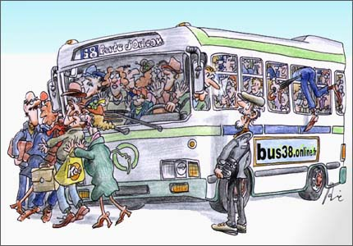
It’s about choices!
Peering
TRANSIT
Remote Peering

Slide 11
Acknowledgements
Bill Norton – Graphs/Diagrams
Ask DrPeering – Whitepaper on remote peering
Drpeering.net

Slide 12
peering@linkedin.com
Notes:
12

